Slide 1
Vigenére Cipher
Kimberly Chiffens
&
Maria Jannelli

Slide 2
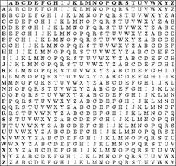
What is it?
Cryptology is the science of securing information
Frenchman Blaise de Vigenere created this cipher based on the polyalphabetic substitution based cipher
This particular cipher involves a multiple shift method
The table used (in the background) consists of the alphabet written out 26 times in different rows, each alphabet shifted cyclically to the left compared to the previous alphabet, corresponding to the 26 possible Caesar ciphers

Slide 3
Why and how it works?
It is easy to apply and helps to learn about cryptology
A long key without repeating letters is more secure
Start with plaintext: WhysoseriousLetsputasmileonthatface (35)
Then the person sending the message chooses a keyword and repeats it until it matches the length of the plaintext, for example, the keyword “darkknight” : darkknightdarkknightdarkknightdarkk (35)

Slide 4
Vigenere Table

Slide 5
Demonstration
Example of encryption:
Plaintext =
Why so serious lets put a smile on that
face
Key= darkknightdarkknightdarkknightdarkk
Ciphertext = ZHPCYFMXPHXSCODFXAATVMZVOBVZOTWFRMONDSCQ

Slide 6
Demonstration
Example of decryption:
Ciphertext = yclhchvalkctqrly
Key= impact
Plaintext = go ahead make my day

Slide 7
References
Principles of Operating Systems: Design and Application, Brian L. Stuart. Course Technology. 2009.

