Slide 1
Digital Media Informatics
WIDENER UNIVERSITY

Slide 3
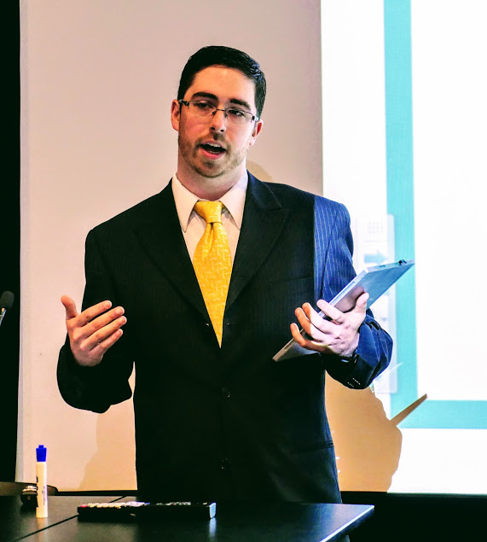
Senior Capstone
Taylor Memorial Arboretum at Widener University
Jon Blaies, Ryan Nakanishi, Avery Bass
https://taylorarboretumwu.wixsite.com/taylorarboretum

Slide 4
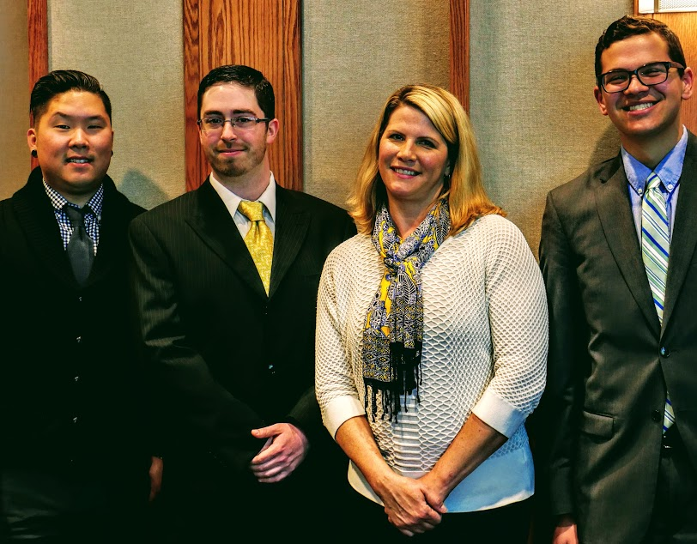

Slide 5
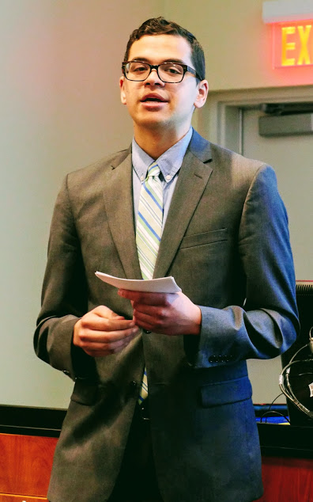
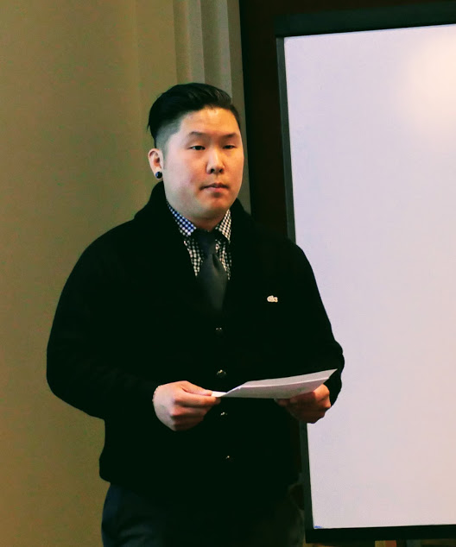

Slide 6
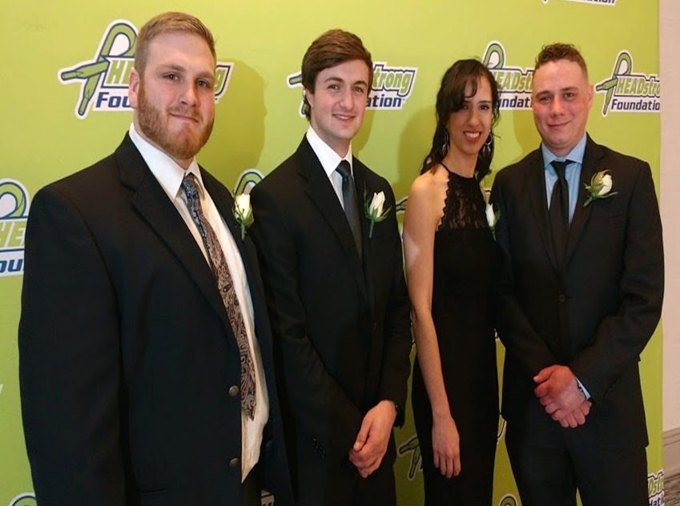
Senior Capstone
HEADstrong Foundation
Zuny Jamatte, Christian Jobs, Zach Michaliszyn, Tyler Smith
Advisor: Dwight DeWerth-Pallmeyer

Slide 7
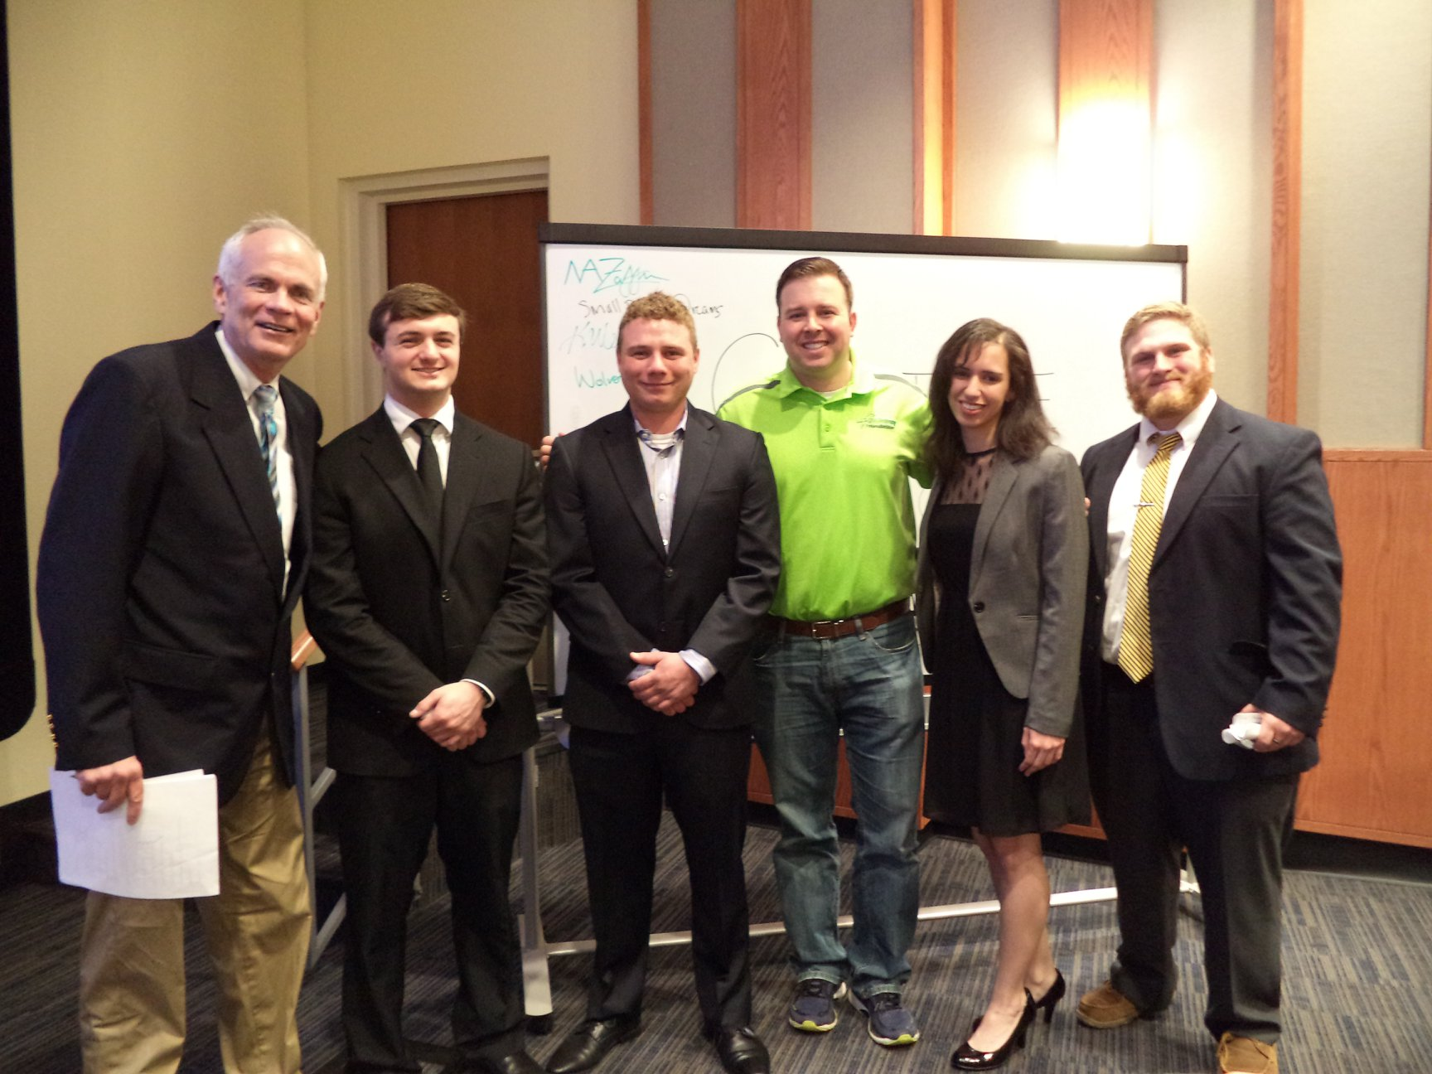

Slide 8
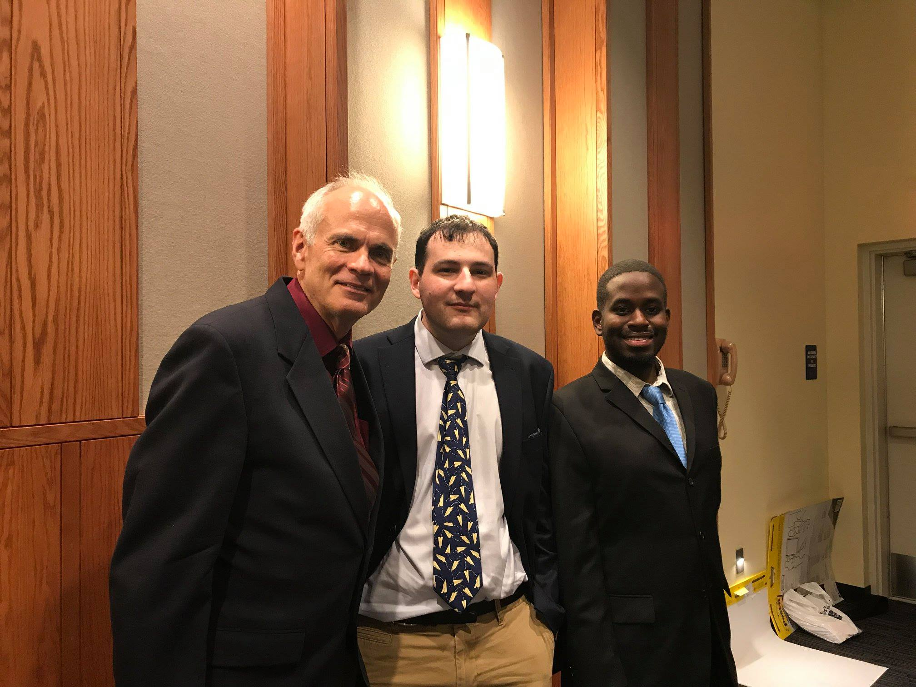

Slide 9
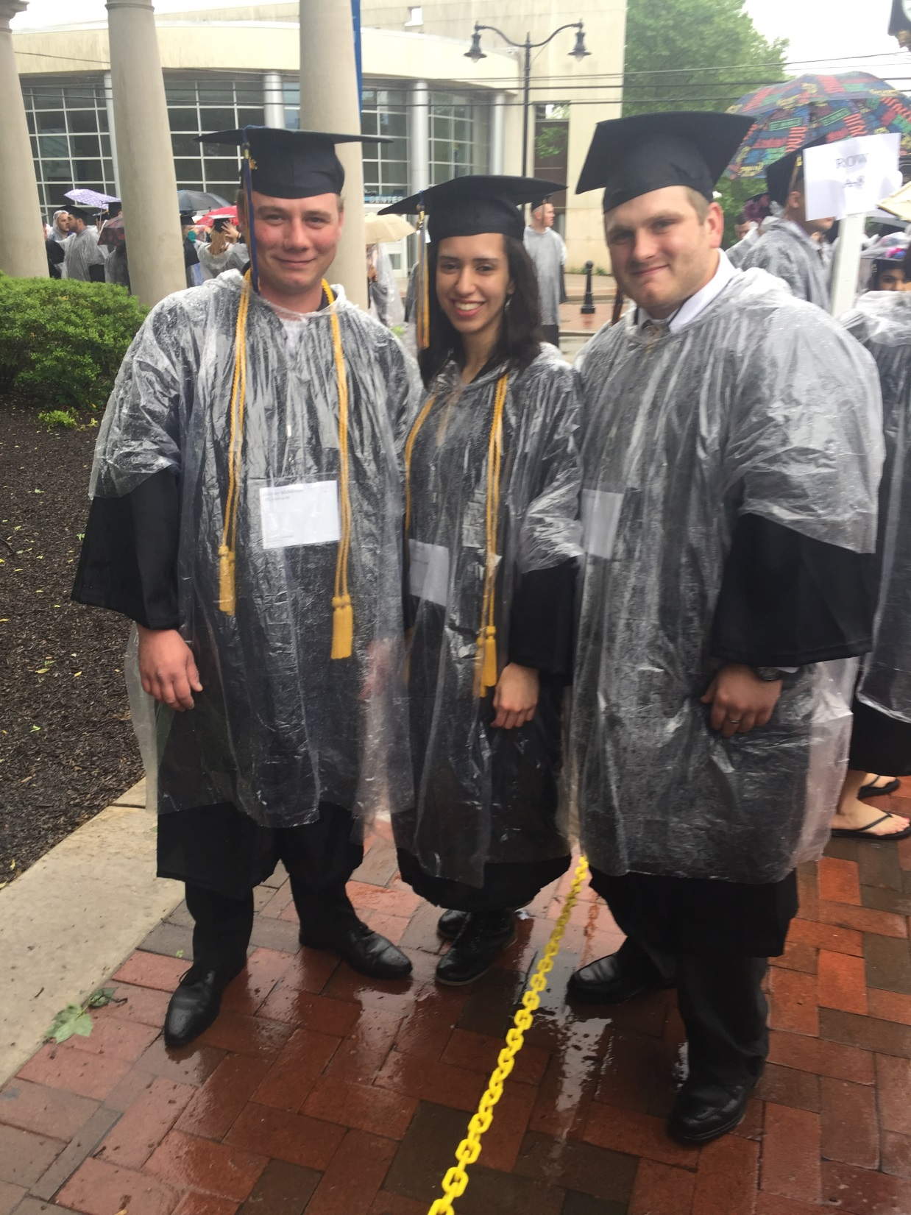
Digital Media Informatics
Alumni
Zuny Jamatte
Zach Michaliszyn
Tyler Smith

Slide 10
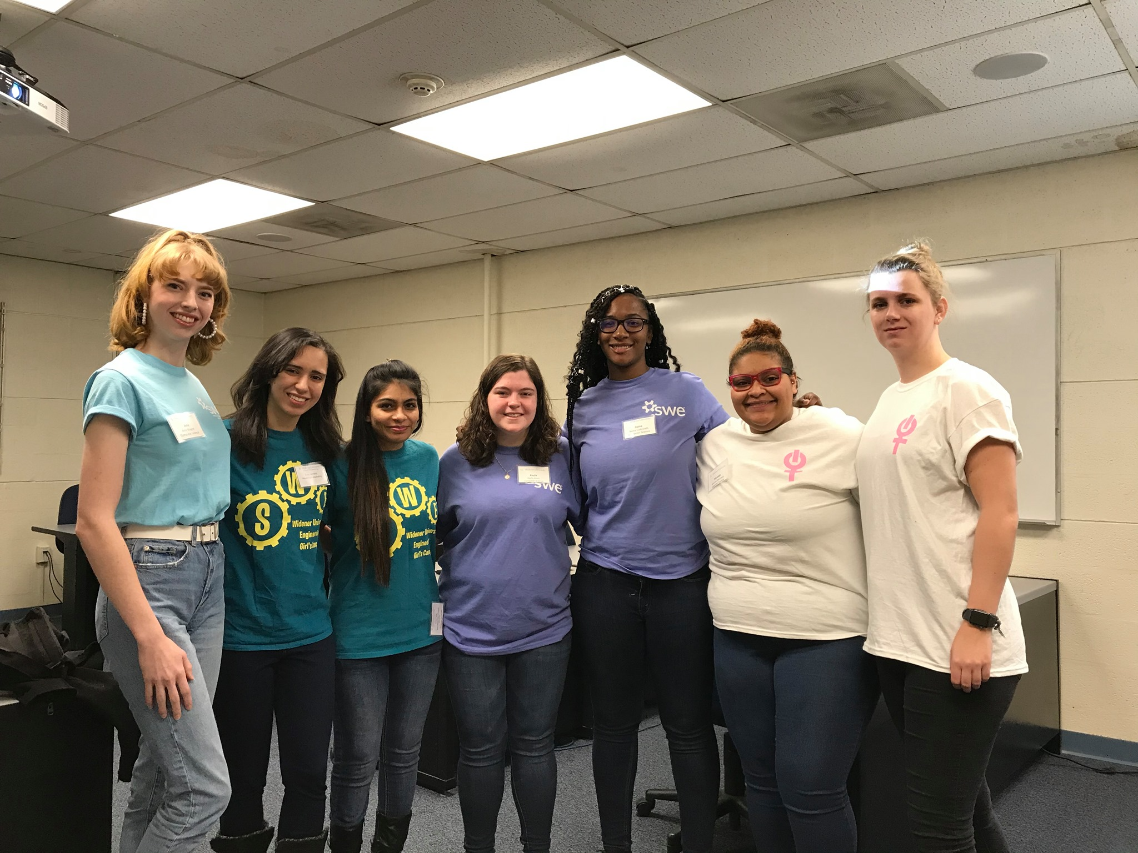
Women in Computing Club

Slide 11
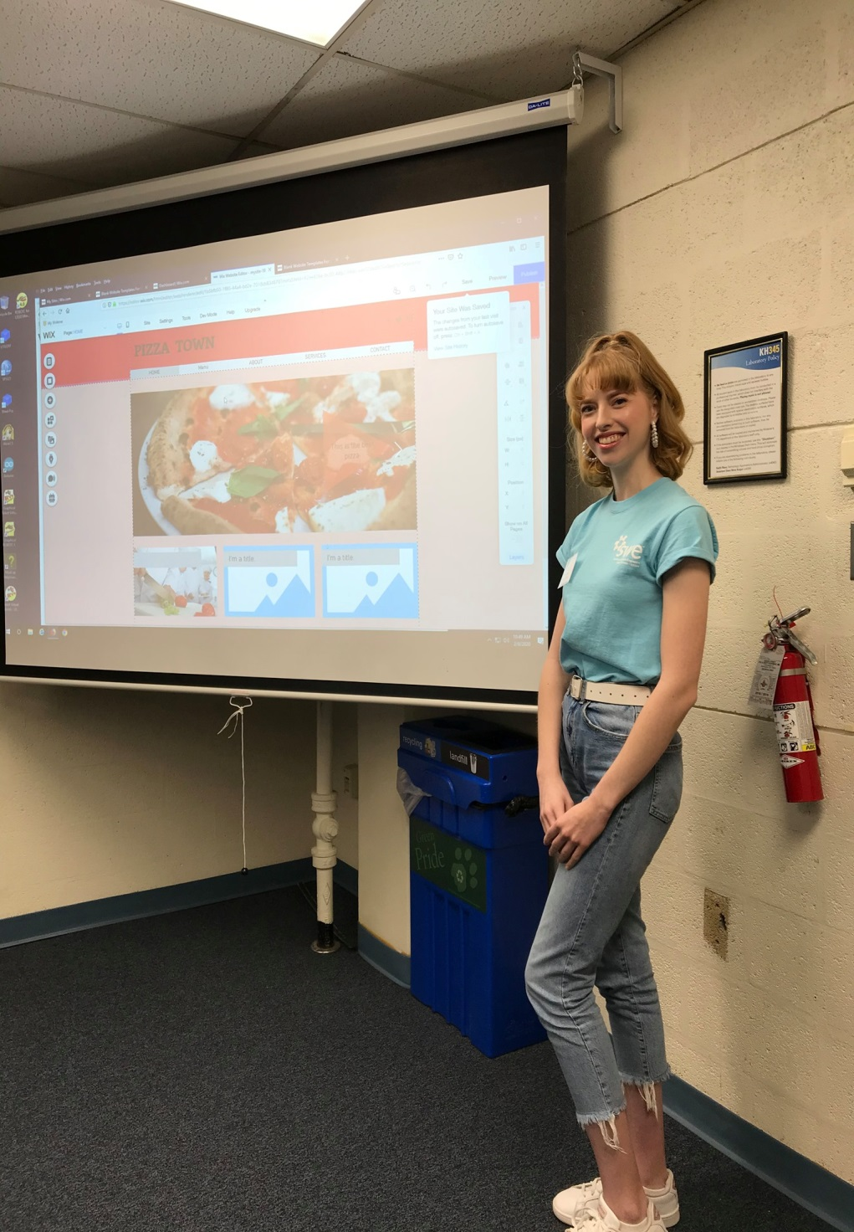
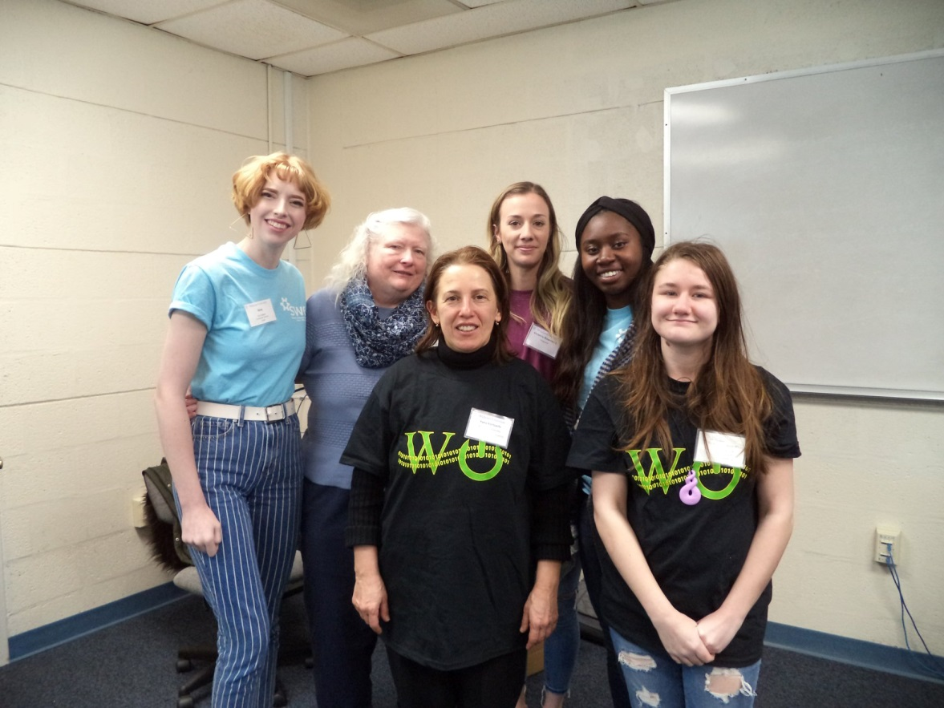
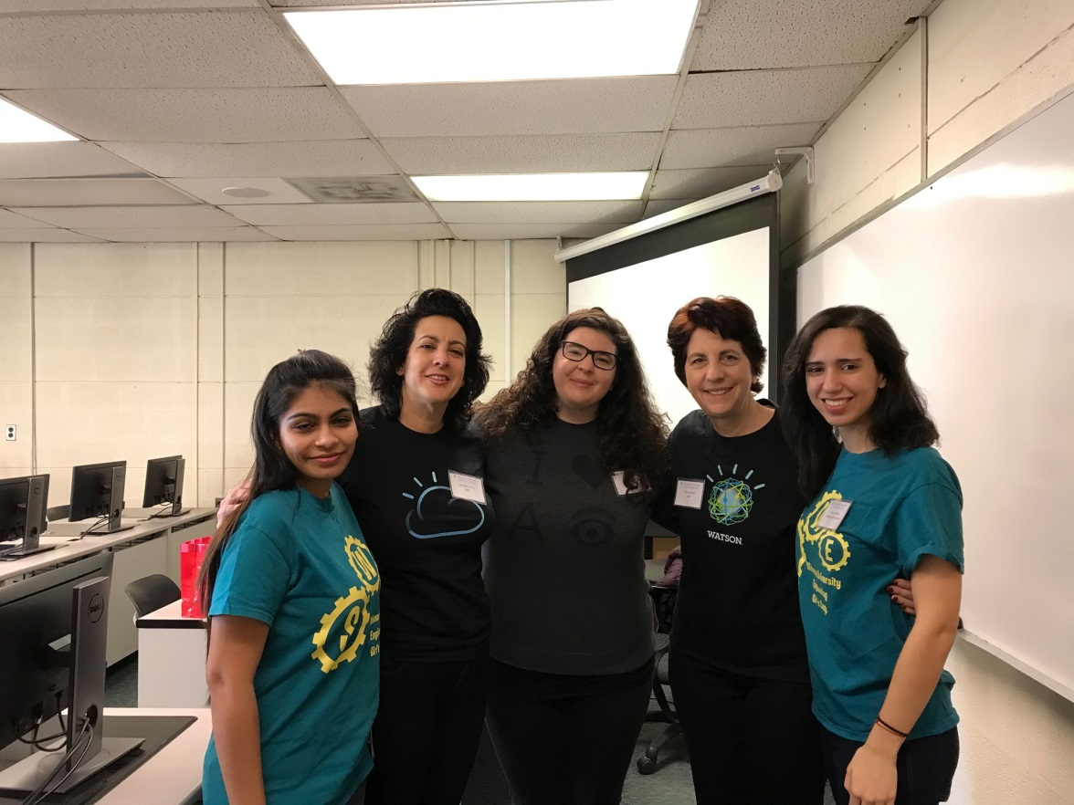
Women in Computing Club

Slide 12
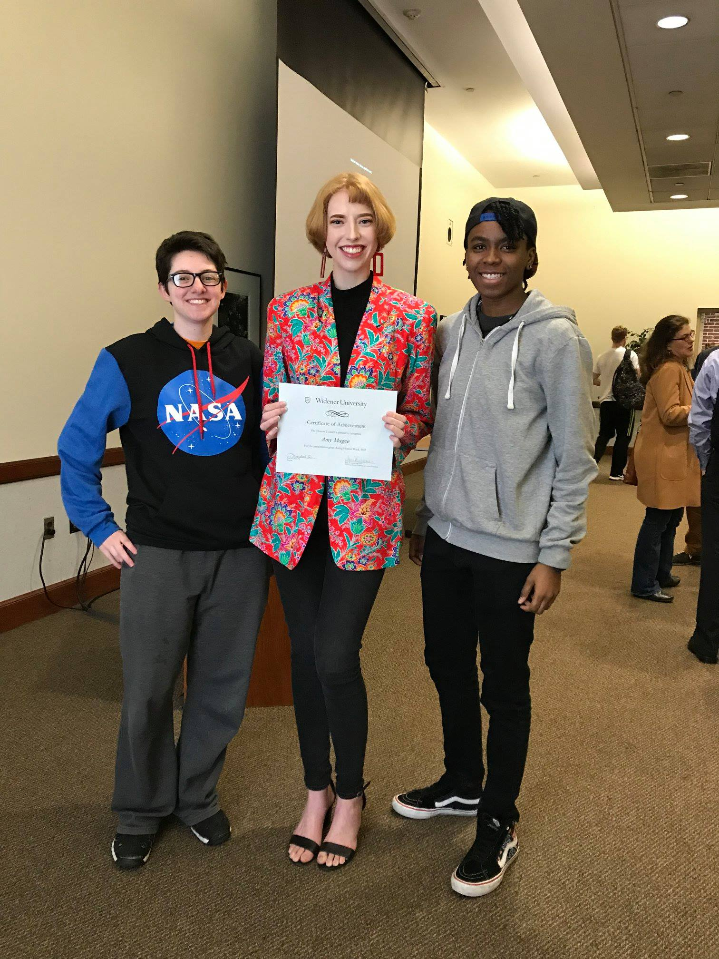
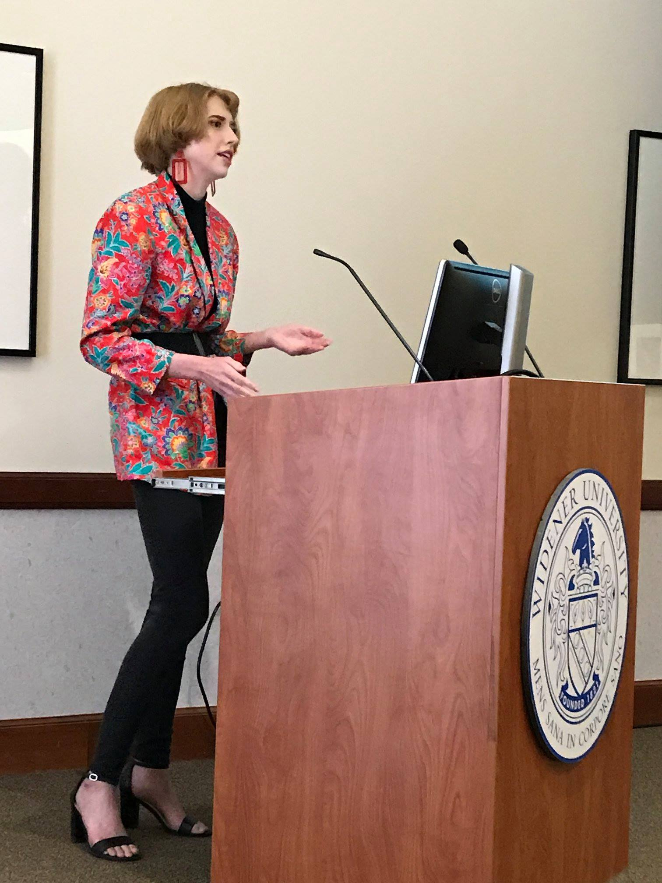
Honors Week

Slide 13
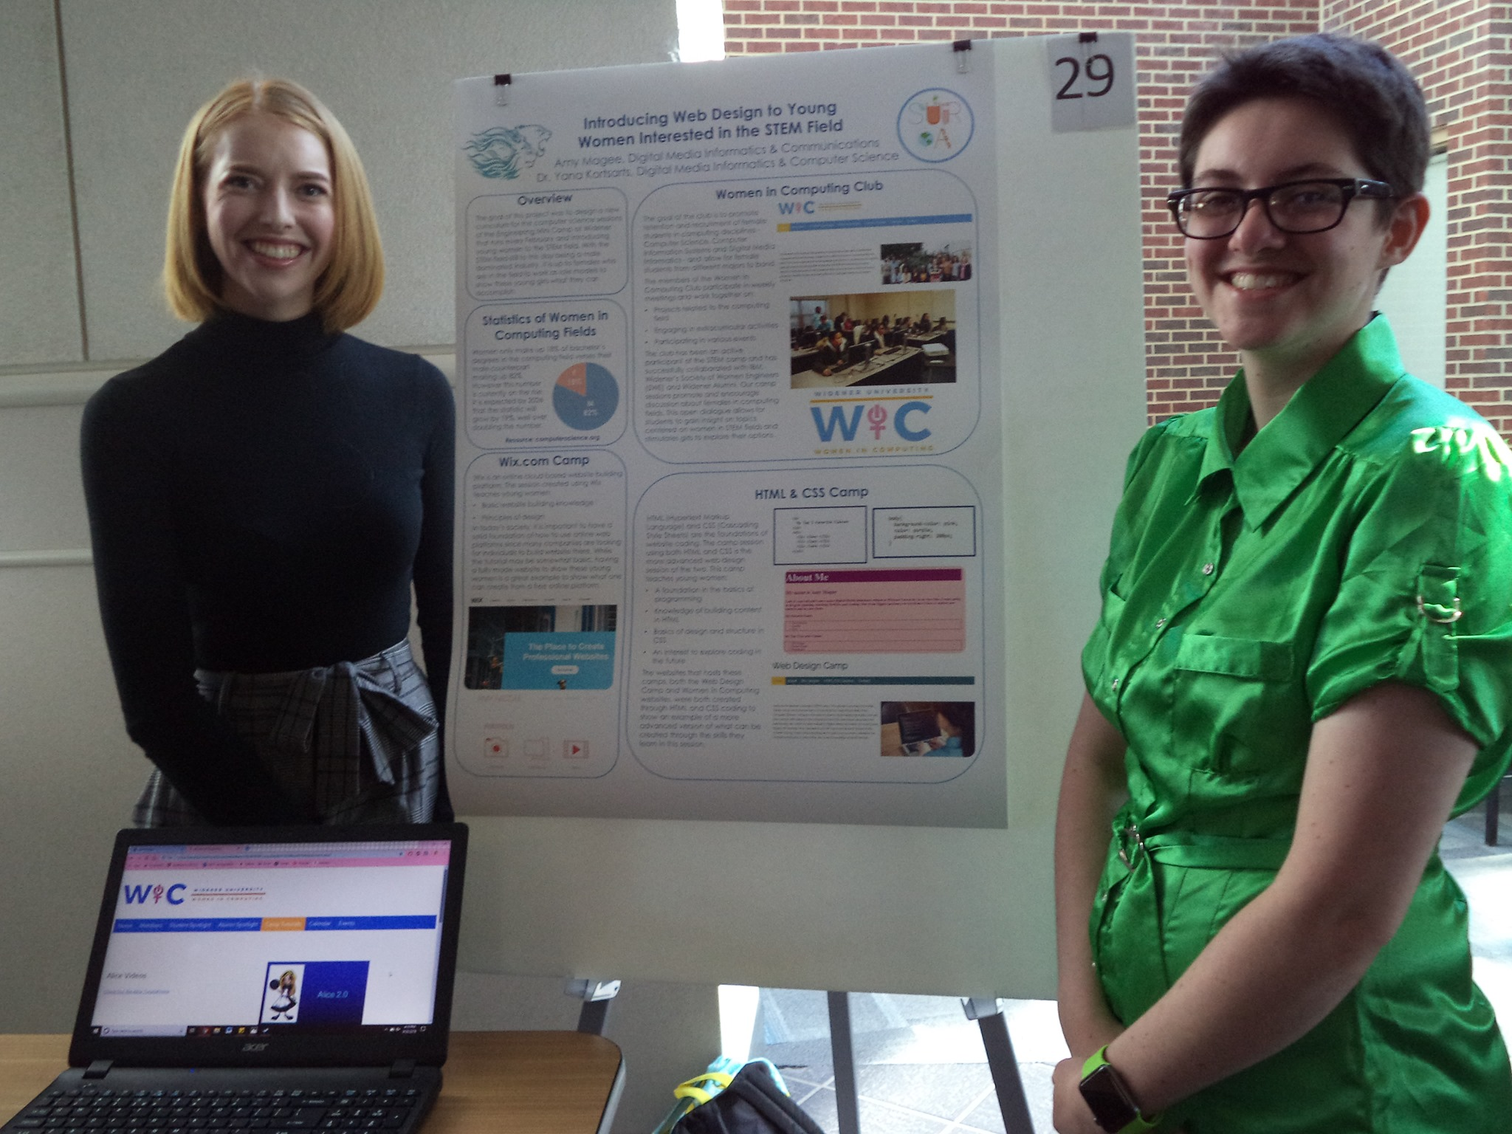
Summer Research Symposium

Slide 14
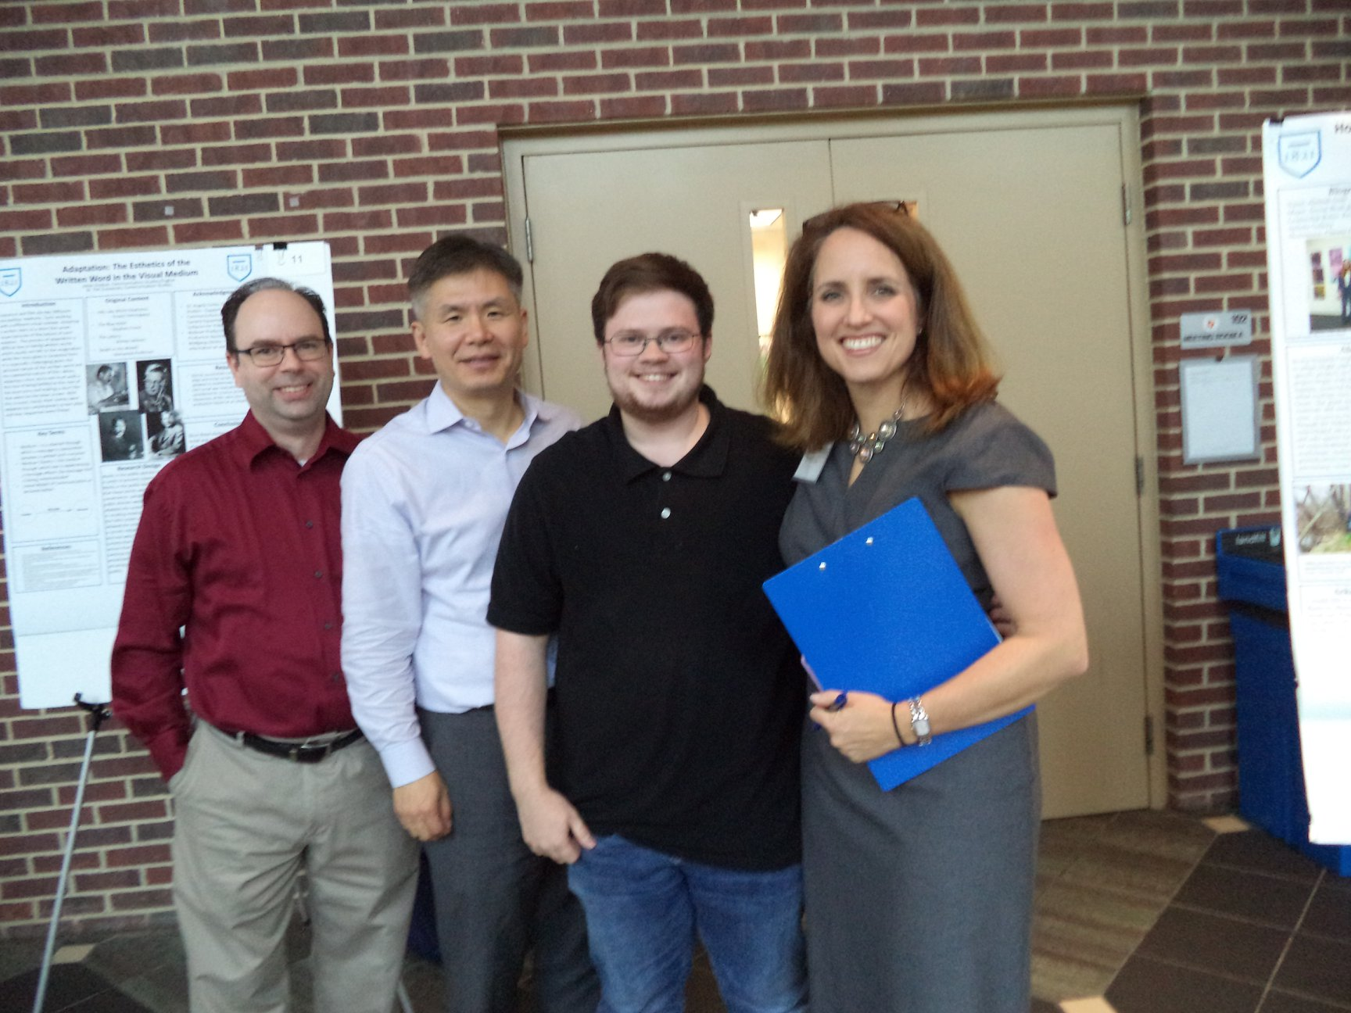

Slide 15
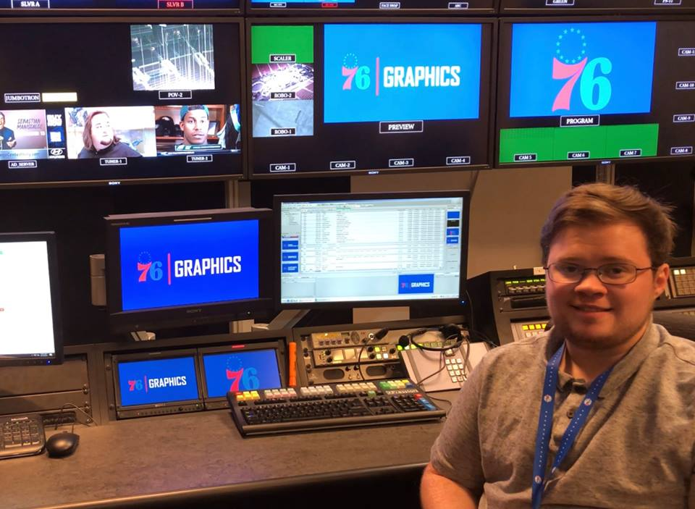

Slide 16
Alumni Spotlight: Digital Media Informatics Alumni Hunter McGinnis Class of 2016, DMI/COMS major
"I started at Widener as a Communications Major, with the intent to go into video editing or graphic designing. Further into my college career, I learned more about what jobs were out there for when I graduated and I started gaining interest in the ones that involved coding and graphics. I then found out that Widener had a major where you learned integration between computer science and communications, so I added Digital Media Informatics as a second major. At the start of my junior year, I accepted an internship with the Philadelphia Flyers and 76ers. Immediately following my internship, they offered me a part time job in game-day production. Since graduating, they were impressed with my background in Digital Media and promoted me to what they call, “Graphics Expert.” I am currently learning the new graphics systems and building the graphics that the 76ers will use throughout the season."

Slide 17
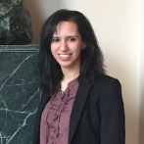
Alumni Spotlight: Zuny Jamatte '18
Current Position
Seed Your Future Intern Longwood Gardens
My Widener Experience
Why did you decide to major in digital media informatics?
I chose to major in DMI, because I liked the fact that it was a combination of the technical aspects of Computer Science with the creativity of Communication Studies. This major allowed me to try different things and learn different topics within my field to find out that I have a multitude of interests.
.
What advice would you give a prospective student considering your major?
The best advice to give to prospective students is to take as many classes as possible, whether you think you will like it or not. You'll never know what else is out there until you try it out and its harder to learn about different things after college. Take advantage of the opportunities and resources available to you at Widener.

Slide 18
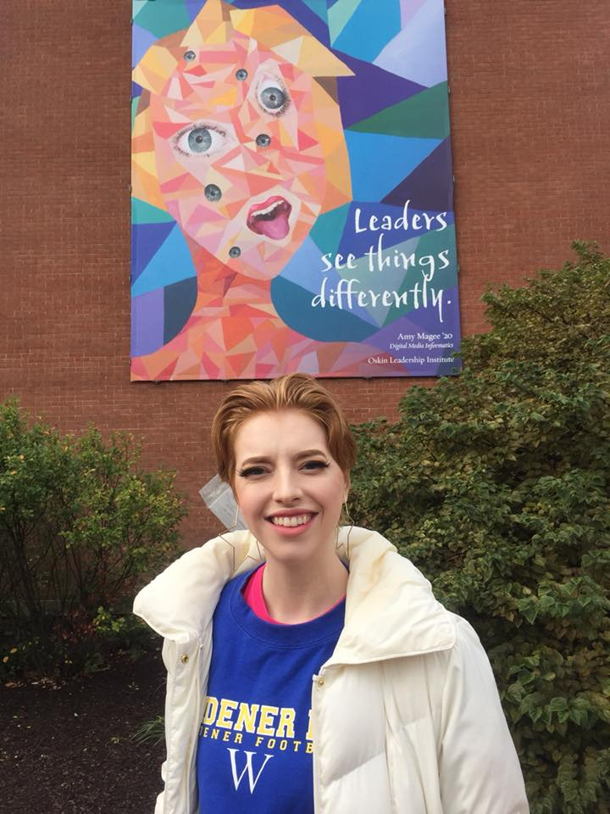
Amy Magee, Digital Media Informatics, Class of 2020 "Art has always been something meaningful in my life, it is a way of visually expressing my passion and creativity to share with others. Many times, however, I can only share my creations with the people close in my life. Recently, I was given an amazing opportunity to work with the Oskin Leadership Institute to create the next leadership banner to be displayed on Kapelski Learning Center. The process of creating the banner was challenging, but working through it with the faculty of Widener University was a great experience. The suspense of waiting for the day to see the banner hang up for all to see felt like forever, but it was definitely worth it. Having a chance for my art to be seen by hundreds of people and share a powerful message of leadership is an amazing feeling. "

