Slide 1
Sabbatical Report
Yana Kortsarts
Computer Science Department, Widener University

Slide 2
THANK YOU!
Widener University
College of Arts and Sciences
Computer Science and Communication Studies Departments
Digital Media Informatics Program

Slide 3
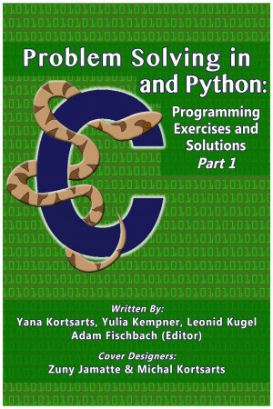
Sabbatical Purpose & Textbook Development
Fall 2023
Collaborative work with Dr. Yulia Kempner, Holon Institute of Technology, Israel
Goal: Develop Part II of the textbook with programming exercises for an introductory programming course
Part I (Published: July 2018)
Available for free on major e-book platforms (Apple Books, Barnes & Noble)
Published with smashwords.com
Variables, input/output, and arithmetic operators; decision structures; and loops

Slide 4
Experience in Teaching Introductory Programming
Extensive experience teaching introductory programming
Teaching at Widener since Fall 2003
Core first-year courses: CSCI 151 & CSCI 152 (Prerequisites for all CS courses)
Programming languages taught:
Prior to 2011: C programming
CSCI 151: Python
CSCI 152: Advanced Python & accelerated C introduction

Slide 5
Teaching Introductory Programming
A key research area in computer science education
Various approaches exist to introduce fundamental programming concepts
Teaching strategies differ among authors
Textbooks vary in pedagogical methods
Not all methods are effective for every audience

Slide 6
Textbook Development
Chapter Structure Finalized
Introduced functions immediately after decision and loop structures, based on teaching experience.
A brief overview of theoretical material for both C and Python
Multiple programming exercise sessions
Sample solutions provided in Python & C
Detailed analysis & step-by-step explanations
Organized exercises into sub-groups by complexity
Dedicated special focus to word problems, emphasizing translation from narrative to code

Slide 7
Chapter 4 Functions
Draft is ready
Currently under review in programming courses
Chapter includes recursive functions
Planning to publish with https://www.draft2digital.com/

Slide 8
Book Structure
Arrays/One Dimensional Lists – without pointers
Pointers/Arrays
Special topics problems
Enriching introductory programming courses with non-intuitive probability experiments component, (2012). Proceedings of the 17th ACM Annual Conference on Innovation and Technology in Computer Science Education (ITiCSE)
Steganography and Cryptography Inspired Enhancement of Introductory Programming Courses, (2015), Information Systems Education Journal (ISEDJ), Volume 13, No. 4, pp. 24 – 32, July 2015
Teaching the power of randomization using a simple game, SIGCSE '06: Proceedings of the 37th SIGCSE technical symposium on Computer science education

Slide 9
Conference Attendance
Research trip to Israel, July 2023
ALGO/ESA European Symposium on Algorithms/WAOA Workshop on Approximation and Online Algorithms 2023, September 4-8, Centrum Wiskunde & Informatica (CWI) national research institute for mathematics and computer science, Amsterdam, Netherlands (Guido van Rossum developed Python in CWI in 1989-1990)

